Slide 1

Academic Year 2023 - 24
S5 MINI PROJECT WORK
First Review
PROJECT TITLE
CAREER CRAFTER – RESUME SCREENING PLATFORM
BATCH MEMBERS
ROSHINI R(7376212CB140)
AKSHAYA R(7376212CB103)
LAKSITA V S(7376212CB127)
GUIDE
Dr PRIYA J
Head of the Department
Department of Computer Science And Business Systems

Slide 2
LITERATURE SURVEY
Sl.No. | Journal Paper Title with Author | Works carried out ( with details of Methods/ Materials/ Software/ Algorithms / fabrication / techniques/ components used ) | Information gathered relevant to your project
1 | Amin, Sujit, et al. "Web application for screening resume." 2019 International Conference on Nascent Technologies in Engineering (ICNTE). IEEE, 2019. | The study by Amin, Sujit, et al. presents a web application for screening resumes. The research focuses on the development and implementation of this technology, providing a platform for automated resume screening. The study contributes to the field of recruitment technology by introducing a tool aimed at enhancing the efficiency of the resume screening process. | SCREENING RESUMES IN A PLATFORM
2 | Jivtode, Alkeshwar, Kisan Jadhav, and Dipali Kandhare. "RESUME ANALYSIS USING MACHINE LEARNING AND NATURAL LANGUAGE PROCESSING." | The presented article discusses the use of machine learning (ML) and natural language processing (NLP) in resume analysis for efficient recruitment. The literature review highlights various approaches such as resume parsing with NLP, recommendation systems using cosine similarity, and ML-based resume ranking systems. | MACHINE LEARNING AND NATURAL LANGUAGE PROCESSING

Slide 3
AIM & OBJECTIVES OF THE PROJECT
(Problem Statement)
    AIM:
To build a website for the recruiters to screen the resume and give proper prediction and suggest some question to be asked.
    OBJECTIVES:
Objective: Streamline resume review for efficient hiring.
Automation: Assist recruiters by automating initial resume evaluation.
Efficiency: Speed up the review process, handling high volumes.
Data Insights: Collect and analyze data for informed hiring decisions.
Time Savings: Free up recruiters for higher-value tasks, improving hiring decisions and workforce productivity.

Slide 4
SCOPE OF THE PROJECT
Promising Scope: Advancing tech, high demand for efficient hiring, and the need for objectivity make resume screening apps promising.
Efficiency Boost: Automation saves time and effort, appealing to organizations of all sizes.
User-Friendly Focus: Intuitive interfaces are crucial for HR, ensuring efficiency.
Rising Demand: Competitive job market fuels the need for efficient candidate screening.

Slide 5
NEED FOR THE CURRENT STUDY
Volume Management: Handles the large influx of job applications efficiently.
Time and Resource Savings: Automates the review process, saving time and reducing manual effort.
Efficiency: Quickly analyzes and filters resumes based on predefined criteria.
Focus on Quality Candidates: Identifies and prioritizes high-potential candidates more effectively.
Scalability: Adapts to fluctuations in hiring needs without proportional increases in resources.
Data-Driven Decision Making: Generates analytics for continuous improvement in the hiring process.

Slide 6
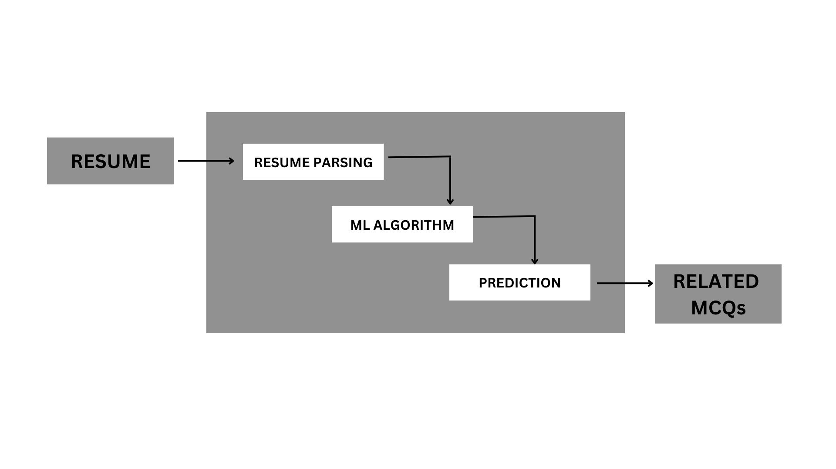
PROPOSED METHODOLOGY ( Flow Chart)

Slide 7
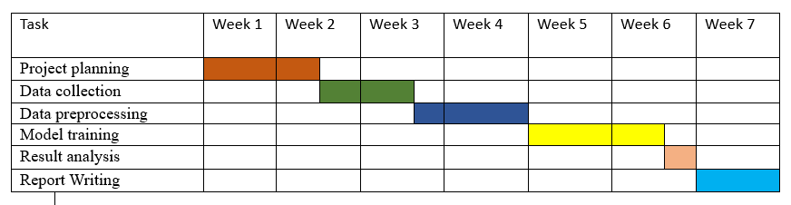
PROPOSED METHODOLOGY ( Gantt Chart)

Slide 8
CHOICE OF COMPONENTS / MODULES / METHODS/TECHNIQUES
EQUIPMENT USED FOR PROJECT DEVELOPMENT
Data Collection: This step involves acquiring data like resumes for predicting the relevant job. This can be collected from resumes submitted.
Data Pre-processing: These can include data cleaning like removing the duplicates, handle missing values and eliminate stopwords.
Feature Extraction: Convert text data into numerical representations using techniques like TF-IDF(Term Frequency- Inverse Document Frequency) or word embedding etc.
Tokens Identification: Breakdown text into individual words or tokens. For Tokenizing, consider not only in word but all in sentence.
Machine Learning Models: Different machine learning models can be employed for resume screening.

Slide 9
CHOICE OF COMPONENTS / MODULES / METHODS/TECHNIQUES
EQUIPMENT USED FOR PROJECT DEVELOPMENT
Validation and Testing: The trained model needs to be validated and tested using a separate dataset to assess its performance accurately.
Hardware and Software: This project requires a CPU with 4 GB RAM and 20 GB memory storage with dual-core processor and a monitor with a high speed internet.

Slide 10
DESIGN(S) (HARDWARE)
Hardware Architecture
Processor: Dual-core processor or higher
RAM: 4 GB or more
Storage: 20 GB free disk space
Internet Connectivity: Broadband connection for seamless data processing

Slide 11
DESIGN(S) (SOFTWARE ARCHITECTURE)
Software Architecture
Data Collection
Data Pre-processing
Feature Extraction
Tokens Identification Using NLP
Machine Learning Model
Validation and Testing
User Interface Using Streamlit
Deployment

Slide 12
DESIGN(S) (HARDWARE / SOFTWARE ARCHITECTURE)
Software Libraries and Frameworks
Python
NLTK
Spacy
Gensim
TextBlob
Pyreparser
Streamlit Framework

Slide 13
INDIVIDUAL CONTRIBUTIONS TO THE WORK
Batch Member 1 : ( 7376212CB140- ROSHINI R)
Prototype designing
Model building
Batch Member 2 : ( 7376212CB103- AKSHAYA R)
Backend
Dataset collection
Batch Member 3 : ( 7376212CB127- LAKSITA V S)
Technical stack search

Slide 14
PLAN FOR PUBLICATIONS
”NATIONAL EDGE COMPUTING SUMMIT: REVOLUTIONIZING CONNECTIVITY AND COMPUTING” (NECSRCC- 2023)

Slide 15
Status on Partial Completion and Submission of Project Report
List of Documents to be Submitted
SL.No | List of Documents | Status ( Provide the drive link of prepared document)
1 | Report | https://docs.google.com/document/d/1KpDR63szDRqAPRUNEmtQ22xKZ7OCHZV_/edit?usp=drive_link&ouid=114067039500288003827&rtpof=true&sd=true

Slide 16
REFERENCES
( Journal Papers/ Books / Website in IEEE Format )
Journal
[1] Amin, Sujit, et al. "Web application for screening resume." 2019 International Conference on Nascent Technologies in Engineering (ICNTE). IEEE, 2019.
[2] Daryani, Chirag, et al. "An automated resume screening system using natural language processing and similarity." ETHICS AND INFORMATION TECHNOLOGY [Internet]. VOLKSON PRESS (2020): 99-103.
[3] Singh, Amit, et al. "PROSPECT: a system for screening candidates for recruitment." Proceedings of the 19th ACM international conference on Information and knowledge management. 2010.
[4] Tijare, Poonam, et al. "A smart resume screening tool for customized shortlisting." ITM Web of Conferences. Vol. 56. EDP Sciences, 2023.
[5] Arora, Sunaina, and Neeraj Kumari. "Recruitment search engines for screening resumes through AI by using boolean search functions." Journal of Asian Development 7.2 (2021): 16-26.
[6] Jivtode, Alkeshwar, Kisan Jadhav, and Dipali Kandhare. "RESUME ANALYSIS USING MACHINE LEARNING AND NATURAL LANGUAGE PROCESSING."

